Slide 1

SMART PENION DISTRIBUTION SYSTEM
.

Slide 2
Abstract:-
This project proposes a tech-enabled simulation model to reduce government pension expenditure by making financially capable adult offspring or family members contribute to their retired parents’ pensions based on their income and assets.
With Andhra Pradesh’s old-age pension at ₹4,000/month (₹48,000/year), the system calculates and automates direct transfers from the childrens' or their spouses’ accounts to the parent’s account, ensuring fairness, reducing family disputes, and avoiding dependency on government funds where unnecessary.
The money saved through this contribution-based approach can be reallocated to rural development initiatives, making pension distribution more sustainable, equitable, and socially responsible.

Slide 3
Objectives:-
The main objectives to be fulfilled are:
Reduce government spending on pensions by involving earning family members.
Create a system that checks income and property before giving full pension.
Give full government pension only to those who truly need it.
Encourage families to support their retired parents if they can afford it.
Transfer pension money directly from family accounts to parents automatically.
Build a model that can be used for other government welfare schemes..

Slide 4
Scope:-
Applies to government pension schemes for senior citizens.
Covers income and property checks of sons, daughters, or their spouses.
Works for both urban and rural families across the state.
Can be used by government officers to track financial data and decide pension sharing.
Helps reduce misuse of pension funds by wealthy families.
Can be extended to other welfare programs like subsidies or healthcare.

Slide 5

What is Pension Scheme?
A pension scheme is a government or
employer-backed program that provides
regular financial support to individuals
after retirement, typically once they reach
a certain age (like 60 years in India). It ensures
a stable income when people are no longer
earning through active employment.
Types:
Government Pension – for senior citizens, widows, disabled, etc.
Employee Pension Schemes – for salaried people (like EPF in India).

Slide 6
Eligibility Criteria for Pension:-
Minimum Age Requirement:
1.Must be 60 years or older (for old age pensions).
Income Limit:
1.Must belong to a Below Poverty Line (BPL) household.
2.Annual family income must be below ₹1,00,000 (varies by state).
Residency Status:
1.Must be a resident of the state where the pension is claimed.
Asset Conditions:
1.Should not own large properties, 4-wheelers, or high-value assets.
2.Owning more than one house, commercial buildings may disqualify.
Documentation Required: Aadhaar card, income certificate, age proof, BPL ration card, bank account details, etc.

Slide 7
Problems Identified:-
1. No check on family income/assets – Pension given even if family is wealthy.
2. No contribution from earning children – Full burden on government.
3. Wastage of public funds – Funds go to those who don’t truly need it.
4. No accountability system – Lack of direct contribution method.
5. No Digital tracking of eligibility based on family status.

Slide 8
Analysis of Problems:-
A retired parent may receive ₹48,000/year pension while:
Son earns ₹15–20L/year
Daughter owns luxury cars, land, and property
These cases don’t justify public funds, leading to:
Inefficiency
Misuse
Unequal access (rural poor receive the same as urban rich)
Even widows and disabled may get full pensions when relatives can afford to support them.

Slide 9
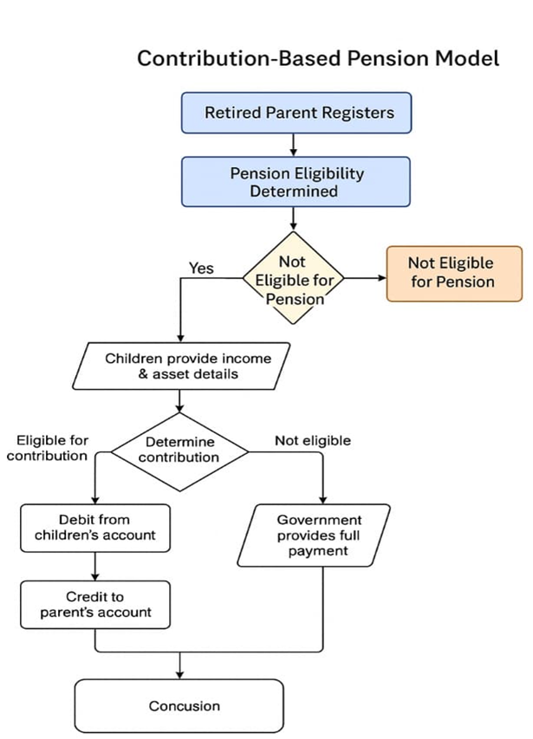
Flow chart:-

Slide 10
Software Solution:-
“Smart Pension Redistribution System”
Simulated web-based system with 3 modules:
Role Features
🧓Parent : Register, link bank account, view contribution breakdown
👨‍Child : Upload income/asset proof, consent to debit, view history
🏛Officer : Verify, monitor, resolve disputes, track government savings
System Logic (for Old-Age Pension ₹48,000/year):
Calculates contribution based on income slabs (100%, 75%, 50% etc.)
Auto-transfers parent pension share from child’s account
If a child earning above ₹10 LPA contributes ₹48,000/year, they become eligible for an income-tax rebate from the government.

Slide 11
For Male Children:
For Female Children:
Income slab | Contribution | Government share
>₹10 lakhs | ₹48,000 | ₹0
₹5-10 lakhs | ₹36,000 | ₹12,000
₹3-5 lakhs | ₹24,000 | ₹24,000
<₹2 lakhs | ₹0 | ₹48,000
Income slab | Contribution(self/husband) | Government Share
>₹10 lakhs | ₹48,000/₹12,000 | ₹0/₹36,000
₹5-10 lakhs | ₹36,000/₹7,200 | ₹12,000/₹40,800
₹3-5 lakhs | ₹24,000/₹0 | ₹24,000/₹48,000

Slide 12
How It Works?
Step-by-Step Flow:
Retired Parent registers on the pension portal → Aadhaar, bank account, and property records linked.
Eligibility check: System verifies if the parent owns major assets (e.g., cars, multi-storey buildings, land). If yes → Not eligible.
Children submit income tax returns, job details, and asset declarations.
For daughters: If unemployed, system checks spouse’s income for contribution eligibility.
System applies income slab logic (100%, 75%, 50%...) and calculates each contributor’s share.

Slide 13
How It Works?
Secure auto-debit simulates direct monthly transfer from child’s/spouse’s account to parent’s bank account via UPI API.
Government pays balance (if child’s contribution is partial or parent qualifies for full support).
Officer dashboard displays:
Eligible and ineligible retirees
Savings to government
Children/spouses contributing
Pending complaints or exemption requests

Slide 14
Conclusion:-
This contribution-based pension model reduces the financial burden on the government by involving financially capable family members in supporting their retired parents. By automating income and asset verification and ensuring direct contributions through secure channels, the system promotes family responsibility, fairness, and transparency. The saved funds can be redirected toward rural development and social welfare, making the pension system more sustainable and efficient.

Slide 15

THANK YOU

